Slide 1
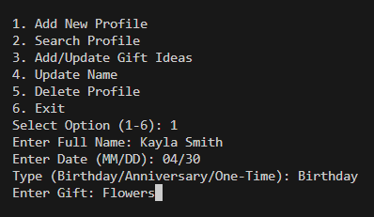
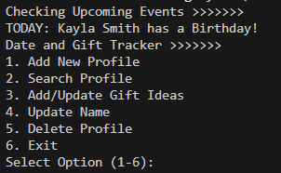
Date and Gift Tracking System
Team Member: Kayla Smith
Replacing the last-minute rush with organized thoughtfulness.
Centralized Profiles
Date Tracking
Advanced Alerts
Gift Log
GITHUB

